Slide 1
Data Structures. (H16Y 35)
Week 1 (Block 2)

Slide 2
To Cover …
Linear Search
Binary Search

Slide 3
Data Structures.
Data Search

Slide 4
Data Search – Intro.
Most operations performed by humans with the use of computers involves storing and retrieving of data/information
Data stored in computer systems can be retrieved by employing data search techniques
Examples of common data search techniques employed are;
Linear Search
Binary Search

Slide 5
Data Structures.
Linear Search (LS)

Slide 6
Linear Search (LS).
Linear search is defined as a search that looks through a list or collection of data one item at a time until the desired search object is located.
It is also known as the sequential search. It searches for a specified value in a list by checking every element in the list
This search is considered to be the simplest search technique because the approach employed by the technique is straightforward and easy to understand.
The input to the linear search method is a sequence (such as an array, collection or a string) and the item that needs to be searched.
The output is true if the specified item is within the provided sequence or false if it is not in the sequence

Slide 7
Linear Search (LS).
To perform a linear search of data held in an array, the search starts at one end (usually the low numbered element of the array) and examines each element in the array until one of two conditions is met.
1st Condition – the target has been found
2nd Condition – the end of the data list has been reached and the target value is not found (i.e. target value not in the data set)
Linear search algorithm requires that both tests are performed (i.e. conditions i & ii) and that the search terminates when one of the conditions becomes true.

Slide 8
Linear Search (LS).- Cont’d
Since this method checks every item in the list until the specified item is found, in the worst case it will go through all the elements in the list before it finds the required element
Note: The simpler the algorithm, the less efficient the search or sort operation is likely to be on very large numbers of records.

Slide 9

Linear Search (LS) – Example 1
Consider the search for data value 7 from the dataset given below:
The Linear search algorithm will attempt to perform the search using the following approach:
The search will scan each item in the list one at a time by starting from the first item in the list (i.e. 23).
The first value in the list is cross-checked against the target value, if no match, the computer looks at the next value…
Once the target value is found, the search is terminated, and the result of the search is reported back to the calling function.
If the search reaches the end of the list without finding a match, the search will be terminated and the result of ‘value not found’ will be reported back meaning target value does not exist in the list.

Slide 10
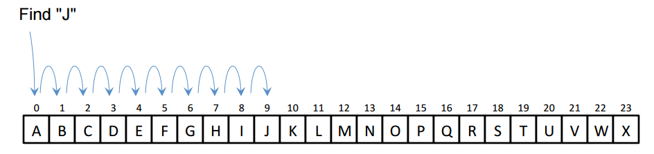
Linear Search (LS) – Example 2
Consider the search to find element ‘J’ from a given sorted list of A-X elements
The example shown above comprises of sorted list of elements A-X located in index points 0-23.
The search will begin from the start of the list and scan all the elements until the target value (i.e. J) is found.
Once the target value is found, the search operation will be terminated and the result is reported back to the calling function.
The result reported will confirm the target was found and the index point (i.e. 9) where the value is located within the list
.

Slide 11
Characteristics of Linear Search
Linear search scans one item at a time, without jumping to any item
Time taken to search elements keep increasing as the number of elements are increased.
Linear search is simple to code, but requires on average to search half of the array each time the target is found
If the target is not in the array then every item in the array will be examined.
Data collection list does not have to be sorted before performing linear search, i.e. linear search can be performed on sorted and unsorted list.

Slide 12
Advantages & Limitation of Linear Search
Advantages
The linear search is simple - It is very easy to understand and implement
It does not require the data in the array to be stored in any particular order
Limitation
Linear search is considered to be too slow to be used when searching elements in large lists as the technique involves searching all items one at a time.

Slide 13
Linear Search - Links
https://www.youtube.com/watch?v=JQhciTuD3E8&nohtml5=False

Slide 14
Data Structures.
Binary Search (BS)

Slide 15
Binary Search (BS).
Binary search is also a method used to locate a specified item in a sorted list
The search technique performs the search on the sorted list by repeatedly dividing the search interval in half.
This method starts by comparing the searched element to the elements in the middle of the list. If the comparison determines that the two elements are equal the method stops and returns the position of the element.
It is a very much faster search method than linear search, but to be effective the data set must be in sorted order in the array.
If the searched element is greater than the middle element, it starts the method again using only the bottom half of the sorted list.

Slide 16
Binary Search (BS).
If the searched element is less than the middle element, it starts the method again using only the top half of the sorted list
If the searched element is not within the list, the method will return a unique value indicating that.
Therefore the binary search method halves the number of elements compared (in each iteration), depending on the result of the comparison.

Slide 17
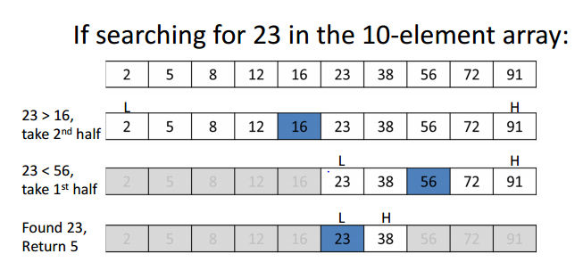
Binary Search – Example 1
Consider the search for data value 23 from the array dataset given below:
Assuming the index point location for the values will be from 0, 1, 2….9, once target value (i.e. 23) is found, the result of the search (index point = 5) is reported back to the calling function.

Slide 18
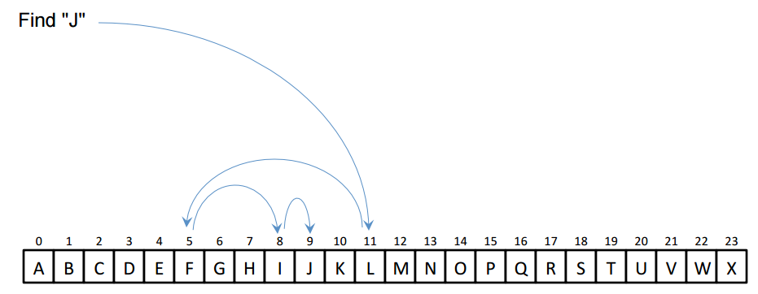
Binary Search – Example 1
Consider the search to find element ‘J’ from a given sorted list of A-X elements
Here the index point location for the elements is from 0, 1, 2….23, once the target value (i.e. J) is found, the result of the search (index point = 9) is reported back to the calling function.

Slide 19
Characteristics of Binary Search
Binary search requires that the list of dataset is sorted prior to performing search.
The search technique performs the search on the sorted list by repeatedly dividing the search interval in half.
It is a very much faster search method than linear search

Slide 20
Advantages & Limitation of Binary Search
Advantages
It is a very much faster search method than linear search
It can be used to perform search on large dataset as compared to linear search
Limitation
For Binary search to be effective, the data set must be in sorted order in the array.
If the data set changes rapidly and requires regular re-sorting then this will offset the speed gain offered by binary search over linear search.

Slide 21
Binary Search - Links
https://www.youtube.com/watch?v=T2sFYY-fT5o&feature=youtu.be

Slide 22
Difference Between Binary & Linear Search
Binary Search | Linear Search
Works only on sorted items. such as Example: 1,2,3,4,5,6 etc. | Works on sorted as well as unsorted items. Example: 12,4,5,3,2,1 etc.
Very efficient if the items are sorted | Very efficient if the items are less and present in the beginning of the list. Example: 12,3,4,5,1 If you want to search for the number – 12, you will find it at the 12 beginning in the list.
Works well with arrays and not on linked lists. | Works with arrays and linked lists
Number of comparisons are less | More number of comparisons are required if the items are present in the later part of the array or its elements are more.

